Slide 1
Task 1: Solving XSS Vulnerable Labs of Portswigger
Steps:
Step 1: Open Kali linux in VMware
Step 2: open firefox and go to portswigger
Step 3: Then go to vulnerable labs list
Step 4: Check Whether the labs vulnerable are available or not
Step 5: Start solving the labs by using payloads
Step 6: You can find payloads in GITHUB
Step 7: Solve any 5 labs to finish the task

Slide 2
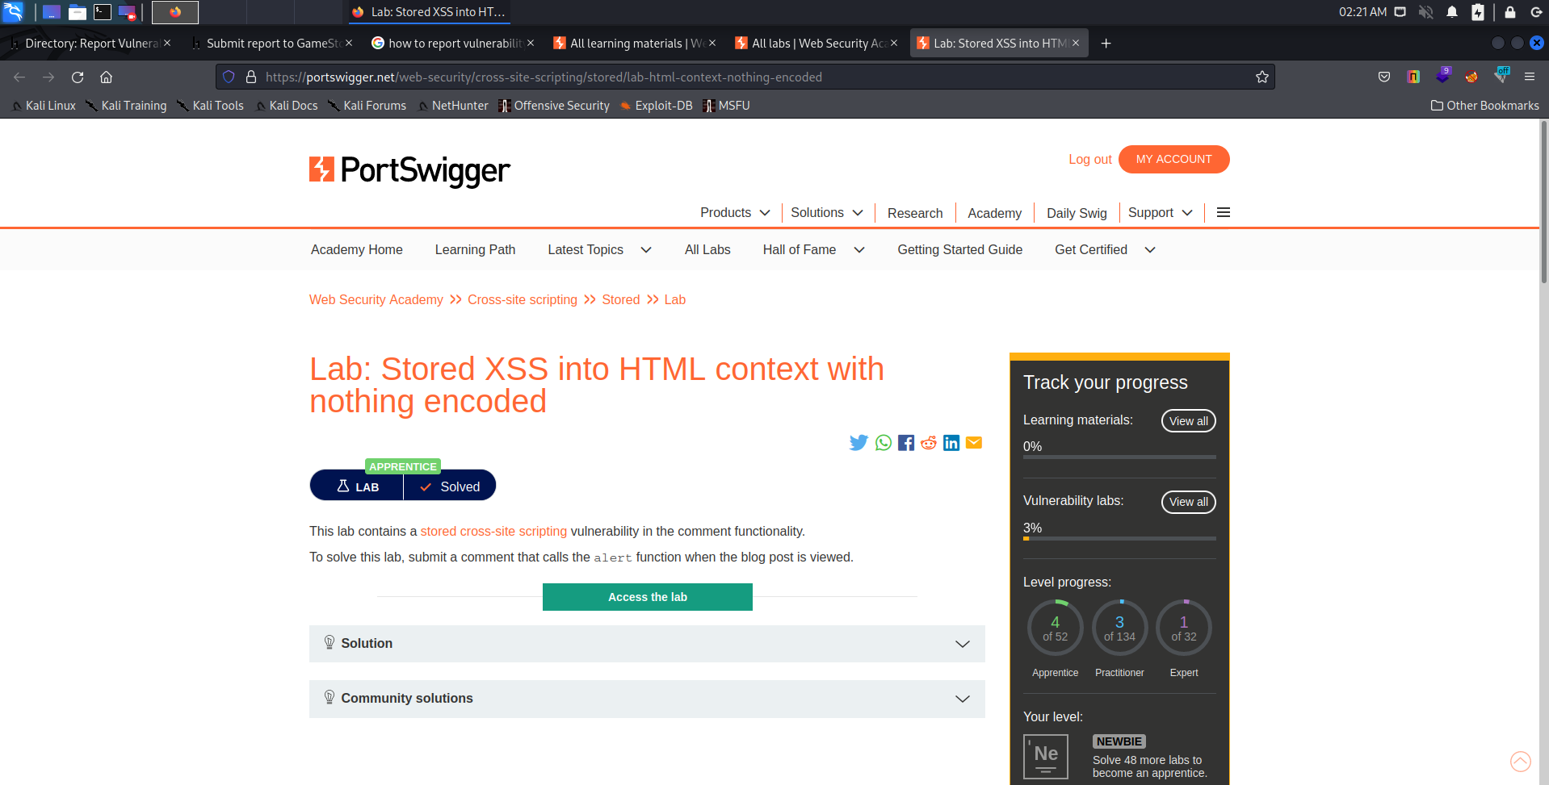

Slide 3
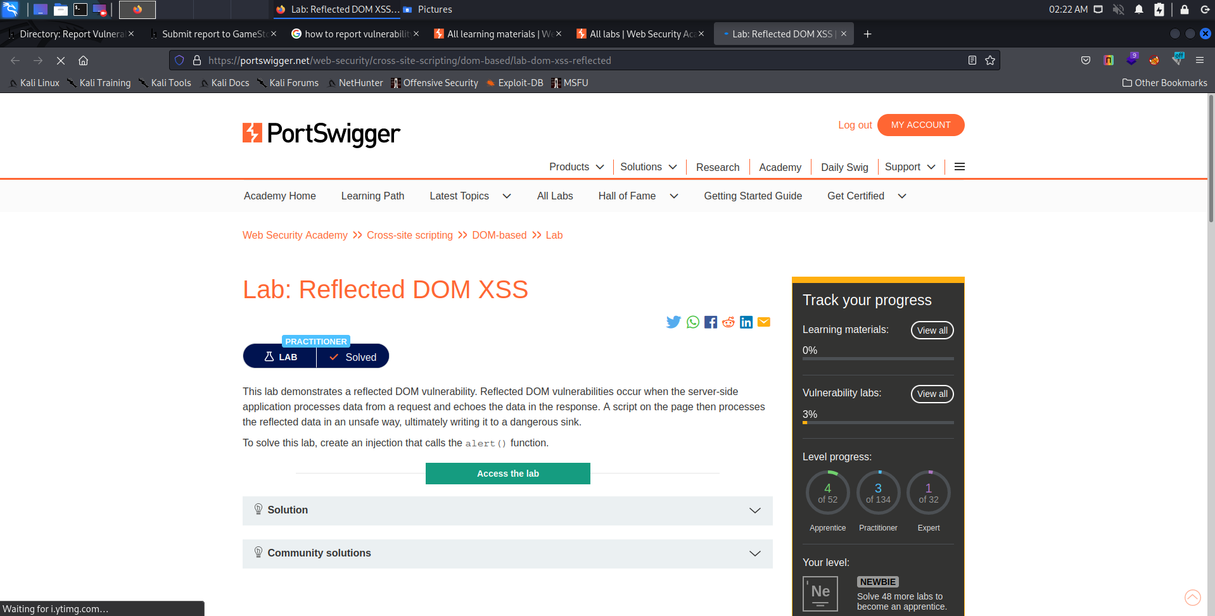

Slide 4
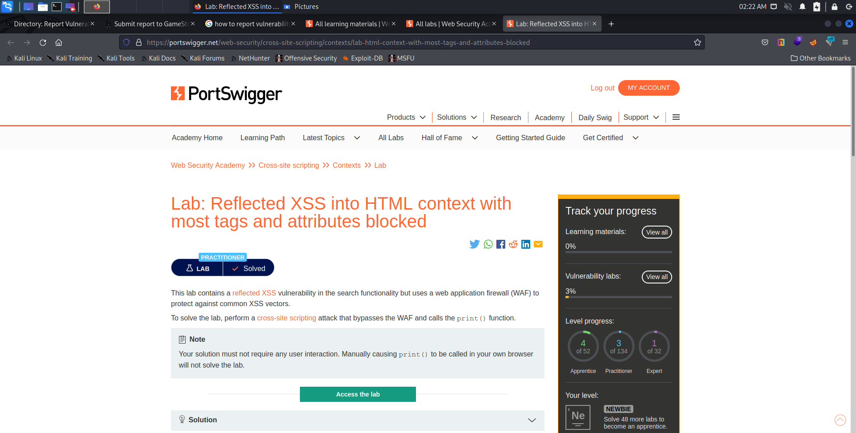

Slide 5
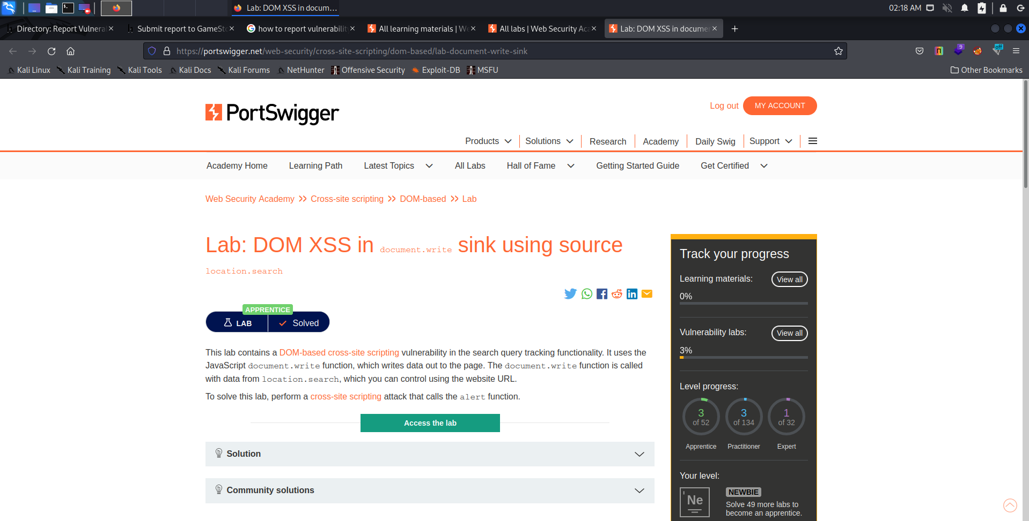

Slide 6
